Slide 1
ECS Internship & Career Services
Voun Sa, Director of career services
Santa clara hall 1204
ecscareer@csus.edu

Slide 2
Services offered
Resume Building
Job/Internship Search
Navigating Handshake
Interviews
Salary Negotiation
Networking
Career Fairs
Info Sessions (Meet the Employers/Lunch & Learn)
On-Campus Interviews
Workshops
**Resume Book (opt in)

Slide 3
SPRING 2023 EVENTS
Career Fairs – February 24th (In Person), April 7th (Virtual)
JCPenney Suite Up Event – Sunday, February 19th (4-7PM) Arden Fair Mall.
Lunch & Learn Series
February 13th – Pavement Coatings Co. (CM,CE)
February 17th – Symsoft (CS, CpE)
February 20Th – Intel (CS, CpE, EEE, Physics, Material Science, Chemical Engineering)

Slide 4
Spring 2023 Workshops
February 8 – Resume Realness
February 15 – Dress for Success
February 16 – Polish Your Digital Profile
February 21 – Resume Realness
February 22 – ECS Career Fair Prep
March 29 – ECS Virtual Career Fair Prep
April 5 – Resume Realness

Slide 5

RESUME 101
What is the purpose of a resume?

Slide 6
Resume: Dos and Don’ts
DO
Tailor your resume to the job you are seeking
Focus on your skills, accomplishments, and abilities
Use action verbs to describe the task you held
Proofread your resume before submitting
Keep to one page (new grad)

Slide 7
Resume dos and don’ts
DON’T
Use fancy fonts/template/pictures
Use Pronouns
Lie or exaggerate
List references

Slide 8

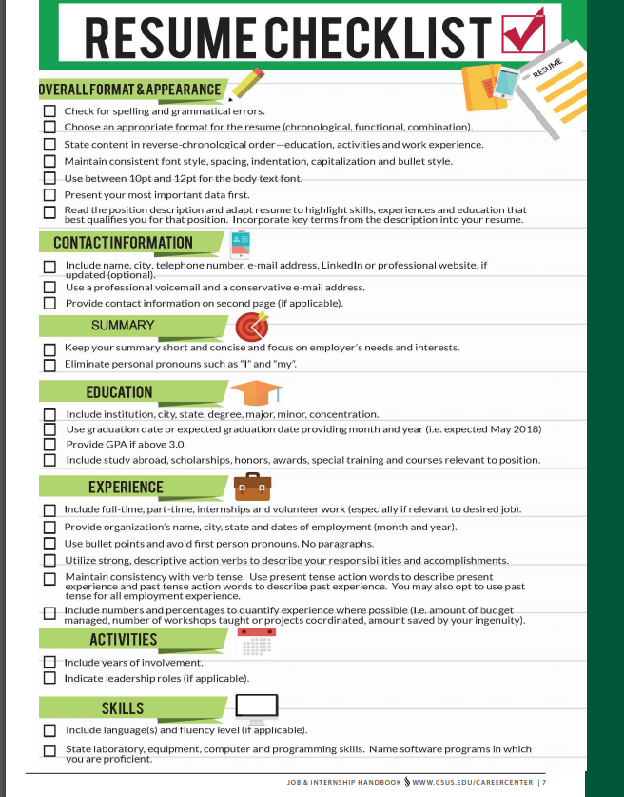
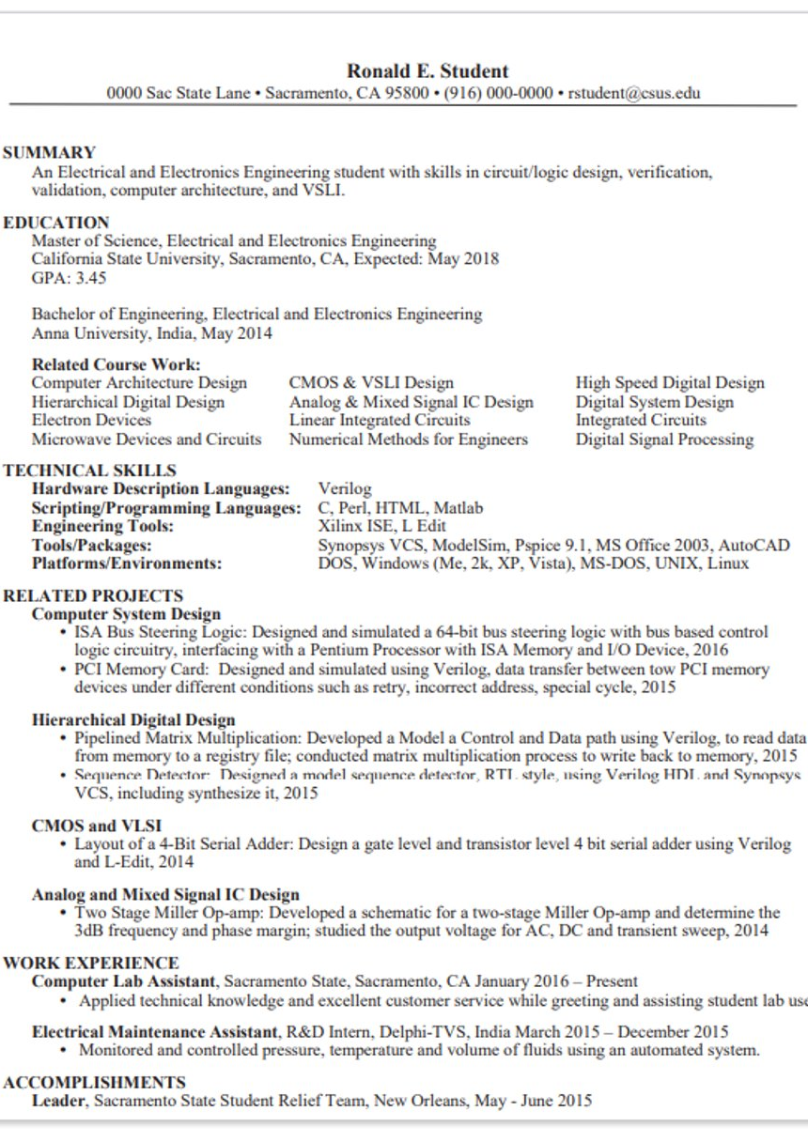

Slide 9
Resume tools and resources
Canvas – SmarThinking (online writing lab)
Make an appointment with a Career Counselor (EAB)
https://www.csus.edu/student-life/career-center/career-counseling/
Job and Internship Handbook: https://www.csus.edu/student-life/career-center/jobs/_internal/_documents/job-handbook-0518.pdf

Slide 10
Ecs career fair prep
Before the Fair…
Update your Handshake Profile/Resume
Register for the Fair
Research/Sign up for sessions
Have your elevator pitch ready
Day of the Fair…
Arrive on time (virtual)
Dress Professionally
Bring copies of your resume
Distraction free environment and Engage (virtual)
Ask Questions
After the Fair…
View and Apply to open jobs/internships
Follow-up
Connect with Recruiters on LinkedIn

Slide 11
Interview preparation
Research
Study the job description
Know who you will be interviewing with (Connect with them on LinkedIn)
Practice Interview (Big Interview: https://csus.biginterview.com/)
Dress appropriately – Business Professional
Bring copies of your resume
Know where you are going
Relax, Be confident

Slide 12
Follow us on social media
LinkedIn, Twitter, Instagram
@sacstateecs, #sacstateecs

Slide 13

handshake
Handshake DEMO
Handshake Jobs & Careers App
Questions?

